Slide 1
COMPUTER GRAPHICS & MULTIMEDIA
UNIT-2
-by Sakshi Jha

Slide 2
SYLLABUS
Clipping Algorithms: Sutherland-Cohen line Clipping Algorithm,
Bezier Curves,
B-Spline Curves.
Parallel projection,
Perspective Projection,
Illumination Model for diffused Reflection,
Ambient light,
Specular Reflection Model,
Reflection Vector.

Slide 3
A curve is an infinitely large set of points. Each point has two neighbors except endpoints.
Broadly, there are three categories :-
Implicit
Explicit
Parametric

Slide 4
A curve is an infinitely large set of points. Each point has two neighbors except endpoints.
Broadly, there are three categories :-
Implicit
Explicit
Parametric

Slide 5


IMPLICIT CURVE
Implicit curve representations define the set of points on a curve by employing a procedure that can test to see if a point in on the curve. Usually, an implicit curve is defined by an implicit function of the form −
$$f\left(x,y\right)=0$$
It can represent multivalued curves multiple y values for an x value. A common example is the circle, whose implicit representation is

Slide 6
EXPLICIT CURVE
The function y = f(x) can be plotted as a curve, which is known as explicit representation of the curve.
For each of the value of x, a single value y is normally computed by the function.

Slide 7

PARAMETRIC CURVE
Parametric curves are the curves which have parametric values. Practically parametric curves are mostly used. The form of a two-dimensional parametric curve is:
The functions f and g become the (x, y) coordinates of any point on the curve, and the points are obtained when the parameter t is varied over a certain interval [a, b], normally [0, 1].

Slide 8
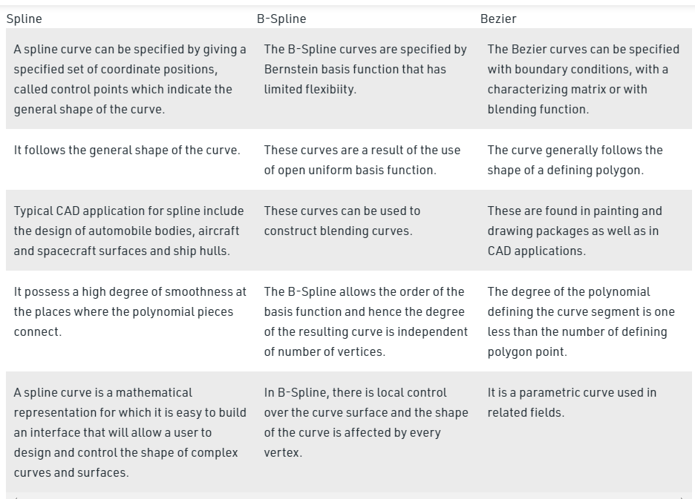
COMPARISON BETWEEN SPLINE ,B-SPLINE & BEZIER CURVE

Slide 9
CURVES IN COMPUTER GRAPHICS Bezier Curve B-Spline Curve

Slide 10
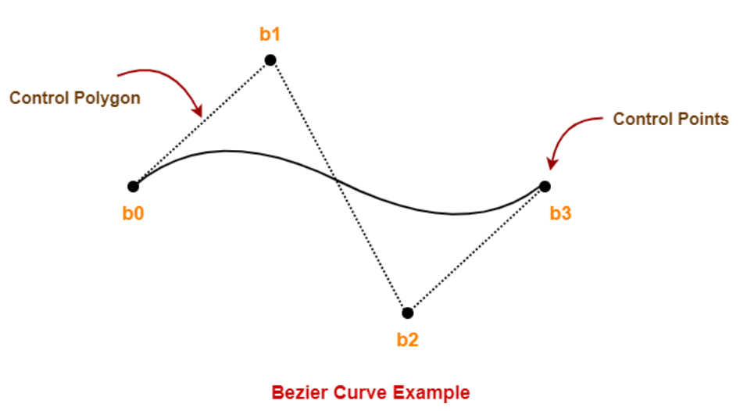
Bezier Curve
The concept of bezier curves was given by Pierre Bezier.
Bezier Curve is parametric curve defined by a set of control points.
Two points are ends of the curve.
Other points determine the shape of the curve.
This bezier curve is defined by a set of control points b0, b1, b2 and b3.
Points b0 and b3 are ends of the curve.
Points b1 and b2 determine the shape of the curve.

Slide 11
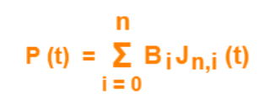
Bezier curve equation :
Here,
t is any parameter where 0 <= t <= 1
P(t) = Any point lying on the bezier curve
B_{i} = i^{th} control point of the bezier curve
n = degree of the curve
J_{n,i}(t) = Blending function = C(n,i)t^{i}(1-t)^{n-i} where C(n,i) = n! / i!(n-i)!

Slide 12
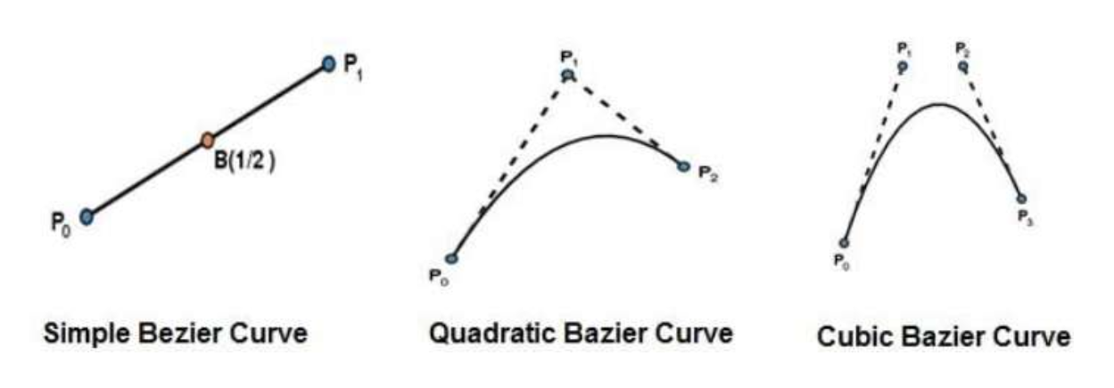
TYPES OF BEZIER CURVE :
1.Simple Bezier Curve : The simplest Bézier curve is the straight line from the point P0 to P1.
2.Quadratic Bezier Curve : A quadratic Bezier curve is determined by three control points.
3.Cubic Bezier Curve : A cubic Bezier curve is determined by four control points.

Slide 13
PROPERTIES OF BEZIER CURVE :
They generally follow the shape of the control polygon, which consists of the segments joining the control points.
They always pass through the first and last control points.
They are contained in the convex hull of their defining control points.
The degree of the polynomial defining the curve segment is one less that the number of defining polygon point. Therefore, for 4 control points, the degree of the polynomial is 3, i.e. cubic polynomial.
A Bezier curve generally follows the shape of the defining polygon.
The direction of the tangent vector at the end points is same as that of the vector determined by first and last segments.
The convex hull property for a Bezier curve ensures that the polynomial smoothly follows the control points.
No straight line intersects a Bezier curve more times than it intersects its control polygon.
They are invariant under an affine transformation.
Bezier curves exhibit global control means moving a control point alters the shape of the whole curve.
A given Bezier curve can be subdivided at a point t=t0 into two Bezier segments which join together at the point corresponding to the parameter value t=t0.

Slide 14
B-SPLINE CURVES
Concept of B-spline curve came to resolve the disadvantages having by Bezier curve.
Both curves are parametric in nature, in Bezier curve we face a problem, when we change any of the control point’s respective location the whole curve shape gets change.
But in B-spline curve, the only a specific segment of the curve-shape gets changes or affected by the changing of the corresponding location of the control points.
In the B-spline curve, the control points impart local control over the curve-shape rather than the global control like Bezier-curve.
B-splines curves are independent of the number of control points and made up of joining the several segments smoothly, where each segment shape is decided by some specific control points that come in that region of segment.

Slide 15
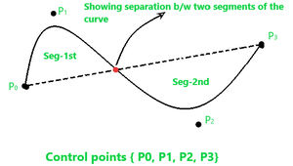
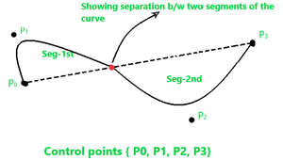
B-spline curve shape before changing the position of control point P1 –
B-spline curve shape after changing the position of control point P1 –
In the above figure that only the segment-1st shape has changed on changing the position of control point P₁, and the shape of segment-2nd remains intact.

Slide 16
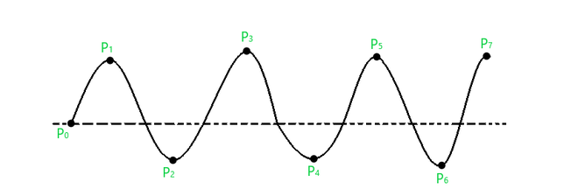
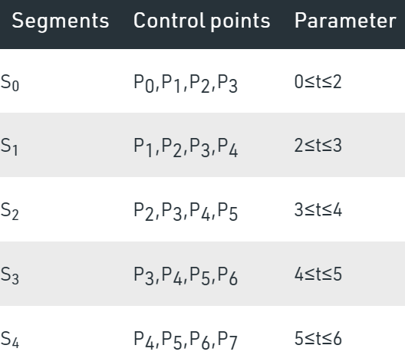
Consider a curve given below –
Attributes of this curve are –
“n+1” control points in the above, so, n+1=8, so n=7.
Let’s assume that the order of this curve is ‘k’, so the curve that we get will be of a polynomial degree of “k-1”.
Conventionally it’s said that the value of ‘k’ must be in the range: 2 ≤ k ≤ n+1. So, let us assume k=4, so the curve degree will be k-1 = 3.
The total number of segments for this curve will be calculated through the following formula –
Total no. of seg = n – k + 2 = 7 – 4 + 2 = 5.

Slide 17
Knots in B-spline Curve :
The point between two segments of a curve that joins each other, such points are known as knots in B-spline curve.
In the case of the cubic polynomial degree curve, the knots are “n+4”. But in other common cases, we have “n+k+1” knots.
So, for the curve in previous slide, the total knots vectors will be –
Total knots = n+k+1 = 7 + 4 + 1 = 12

Slide 18
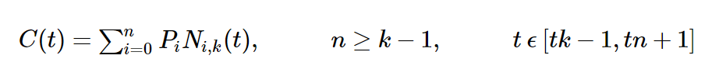
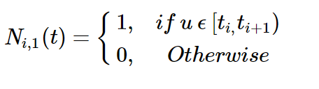

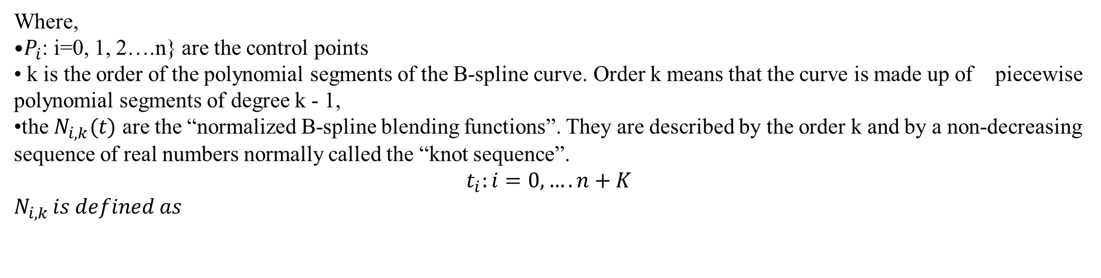
B-Spline Curve Equation
The B-spline basis contains the Bernstein basis as the special case. The B-spline basis is non-global.
A B-spline curve is defined as a linear combination of control points $P_{i}$ and B-spline basis function $N_{ik}(t)$, given by
Where,
$P_{i}$: i=0, 1, 2….n} are the control points
k is the order of the polynomial segments of the B-spline curve. Order k means that the curve is made up of piecewise polynomial segments of degree k - 1,
the $N_{i,k}(t)$ are the “normalized B-spline blending functions”. They are described by the order k and by a non-decreasing sequence of real numbers normally called the “knot sequence”.
$$t_{i}:i=0,….n+K$$
$$N_{i,k }is defined as$$

Slide 19
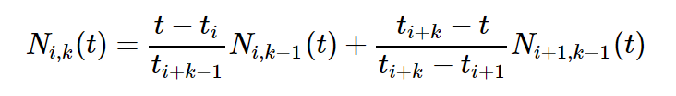

and if k > 1,
and

Slide 20
PROPERTIES OF B-SPLINE CURVES
The sum of the B-spline basis functions for any parameter value is 1.
Each basis function is positive or zero for all parameter values.
Each basis function has precisely one maximum value, except for k=1.
The maximum order of the curve is equal to the number of vertices of defining polygon.
The degree of B-spline polynomial is independent on the number of vertices of defining polygon.
B-spline allows the local control over the curve surface because each vertex affects the shape of a curve only over a range of parameter values where its associated basis function is nonzero.
The curve exhibits the variation diminishing property.
The curve generally follows the shape of defining polygon.
Any affine transformation can be applied to the curve by applying it to the vertices of defining polygon.
The curve line within the convex hull of its defining polygon.

